Slide 1

Exam AZ-301: Microsoft Azure Architect Design Crash Course
Tim Warner

Slide 2


Tim Warner
Based in Nashville, TN, US
MCT, MVP
Twitter: @TechTrainerTim
Badge: timw.info/azarchcert

Slide 3
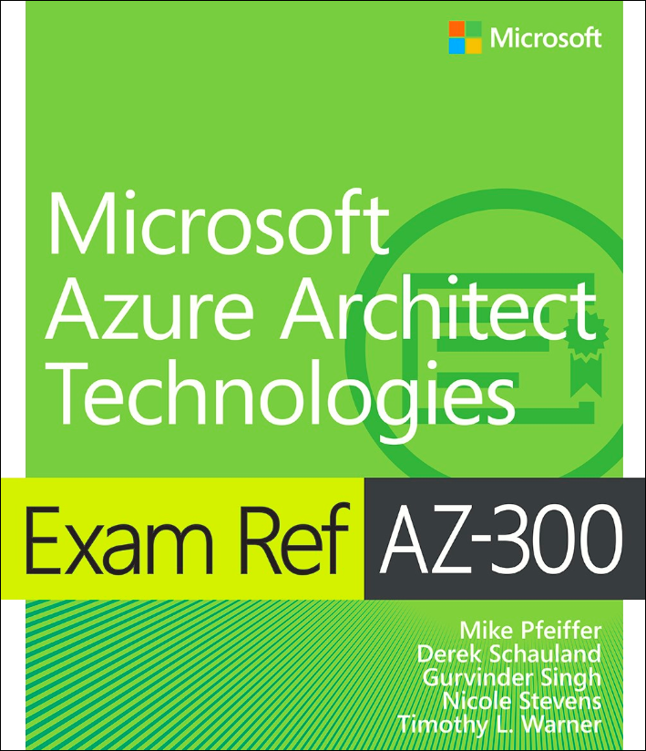
Tim Warner
timw.info/ms300
Safari Books Online

Slide 4
Course Materials
timw.info/az301

Slide 5
Session 1 of 2 Learning Goals
Introduction
Consumption, Auditing, Monitoring Design
Accounting
Identity Design
Authentication
Authorization
Data Platform Solution Design
Relational vs non-relational databases
Data protection

Slide 6
Session 2 of 2 Learning Goals
Business Continuity / High Availability Design
ASR
Autoscaling
Load balancing
Deployment, Migration, Integration Design
IaaS
PaaS
Migrations

Slide 7
Level set
Azure Architect is an expert-level certification
You should already know how to deploy and configure Azure resources
This is a "crash course"
Please plan to review these materials more than once
Five-minute break at midpoint
Please ask/answer questions and provide feedback in the Q/A panel, not the group chat

Slide 8
AZ-300/301 Changes in 2020
Reference: https://timw.info/az2020
Exam content reviewed every 2 months
Certs reviewed every 1 year
Beginning in March 2020:
AZ-300 becomes AZ-303
AZ-301 becomes AZ-304
AZ-300/AZ-301 will remain on market for 90 days after the new version becomes available

Slide 9
Tim's Certification Study Pyramid
Interdependence
Content knowledge
Practical application
Test-taking skills

Slide 10
Consumption, Auditing, Monitoring Design

Slide 11
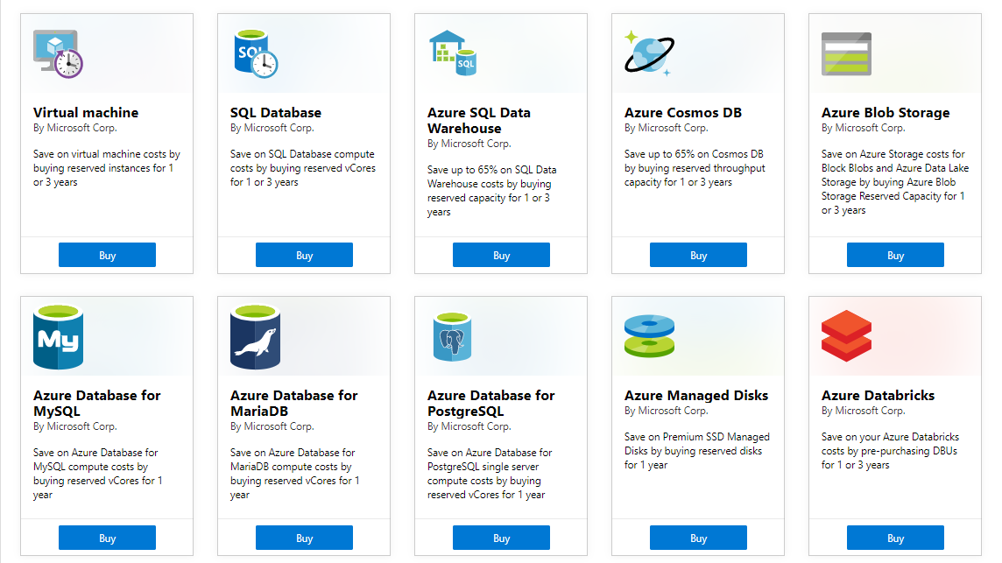
Azure Reservations

Slide 12
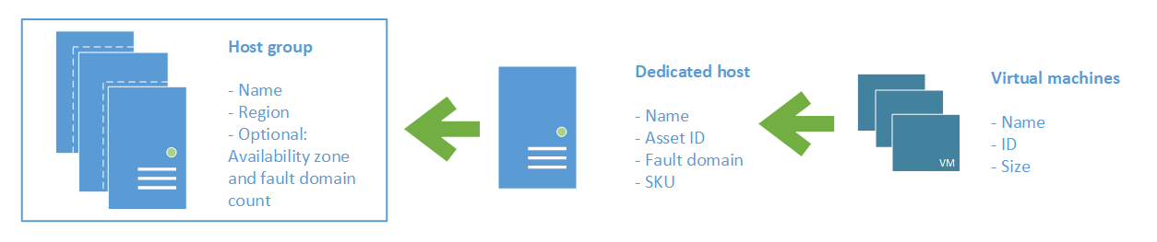
Azure Dedicated Host

Slide 13
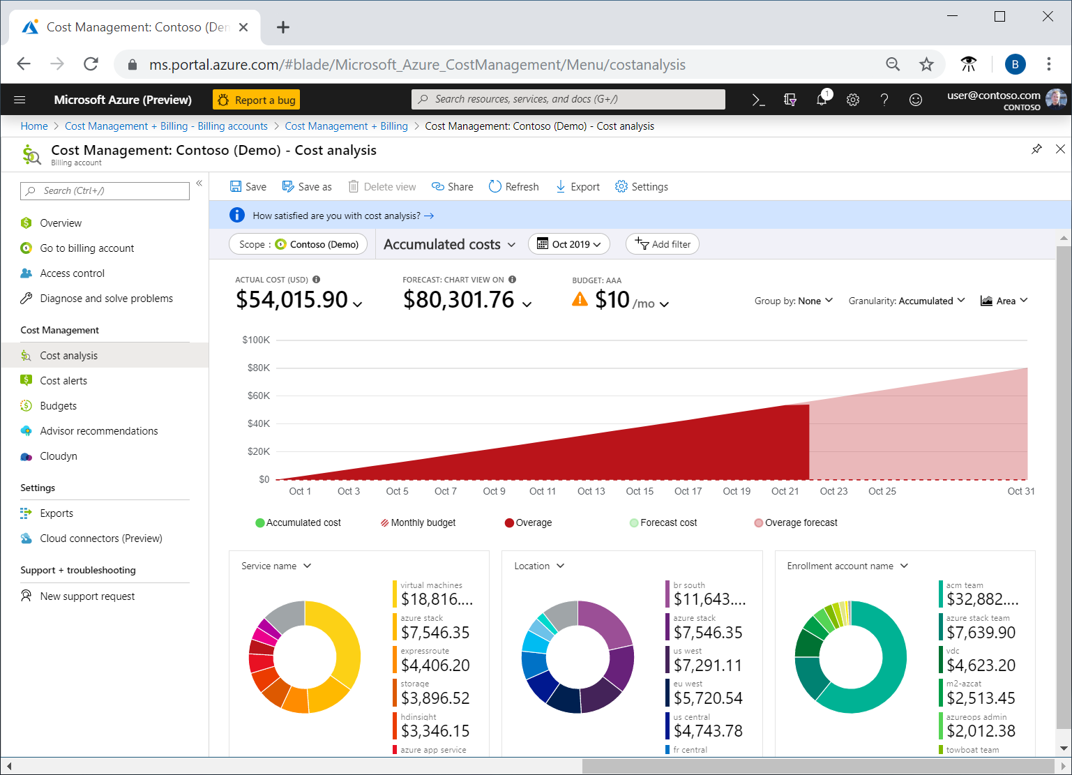
Azure Cost Analysis

Slide 14
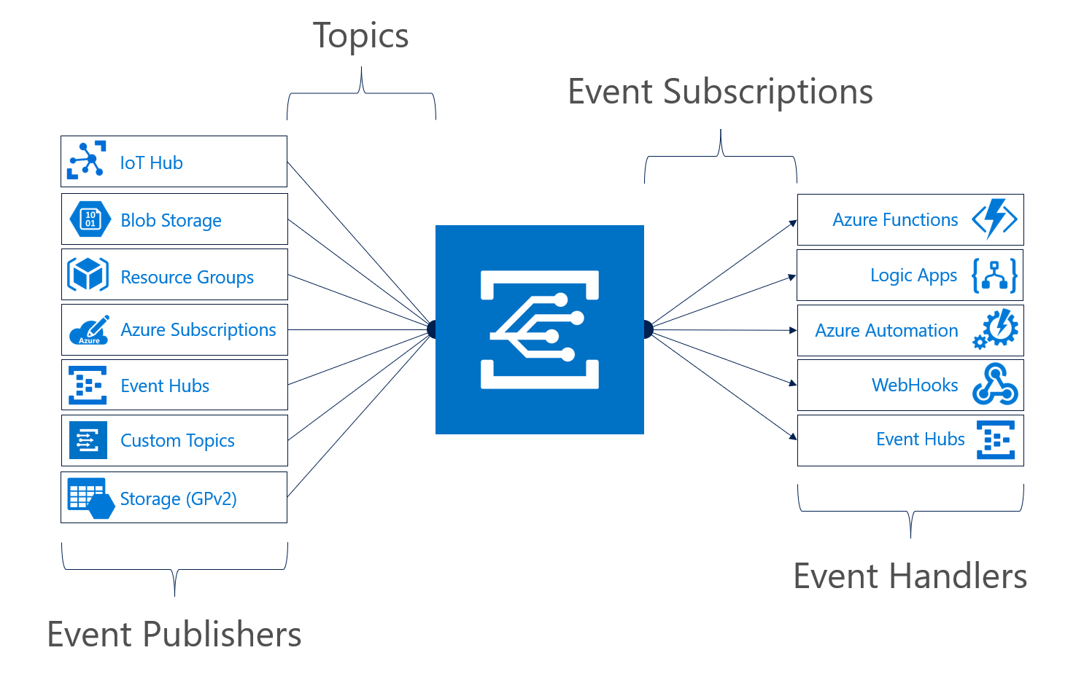
Azure Event Grid

Slide 15
Identity Design

Slide 16


Azure AD and Subscriptions

Slide 17

Azure AD B2C

Slide 18

Azure AD Domain Services

Slide 19
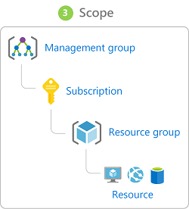
Azure Management Scopes
/ Tenant Root

Slide 20

Azure AD SSO

Slide 21

Passthrough Authentication

Slide 22

Seamless Single Sign-On

Slide 23

AD FS Federation

Slide 24
Data Platform Solution Design

Slide 25

Availability Set

Slide 26

Availability Zone

Slide 27
Storage Account Replication
1
3
3
2
LRS
ZRS

Slide 28
Storage Account Replication
1
3
1
3
2
2
GRS – RA/GRS

Slide 29
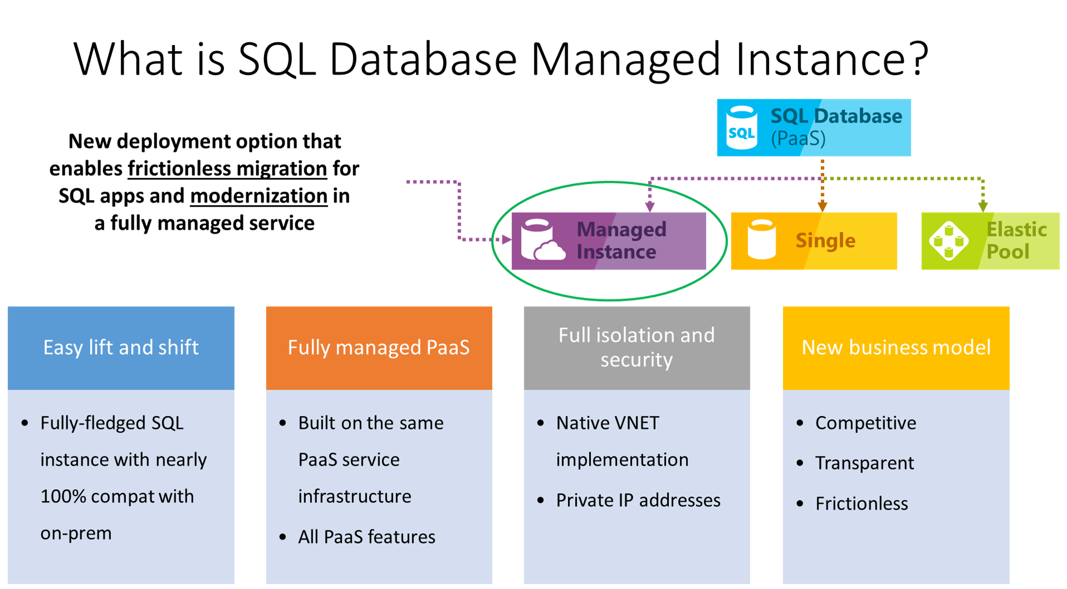

Slide 30
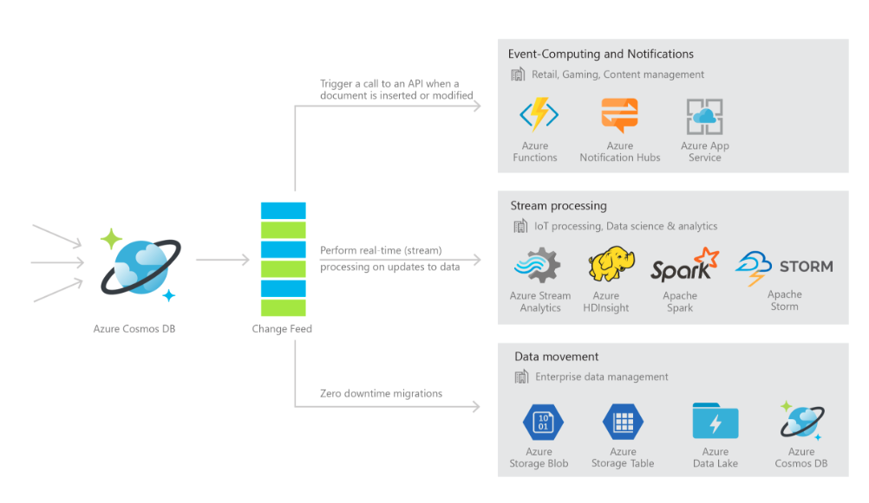
Cosmos DB

Slide 31

Always Encrypted

Slide 32
Business Continuity/High Availability Design

Slide 33
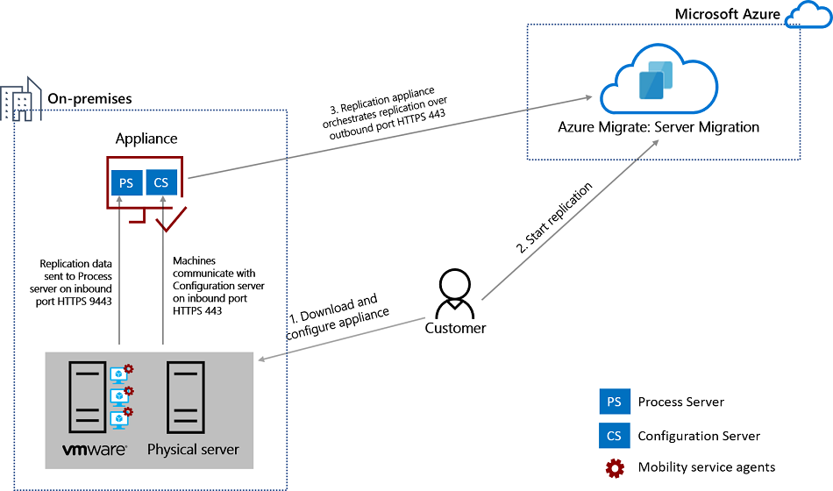
Azure Migrate

Slide 34
Deployment, Migration, Integration Design

Slide 35

VM High Availability

Slide 36

Web App High Availability

Slide 37
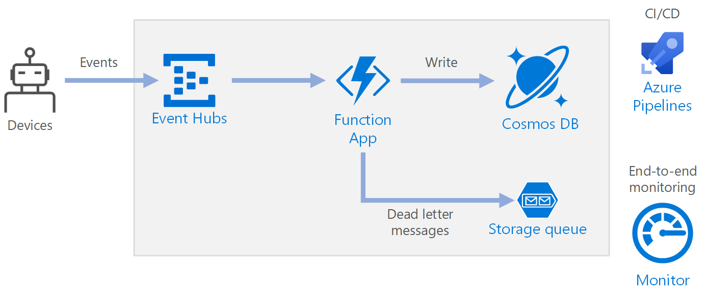
Azure Event Pipeline

Slide 38
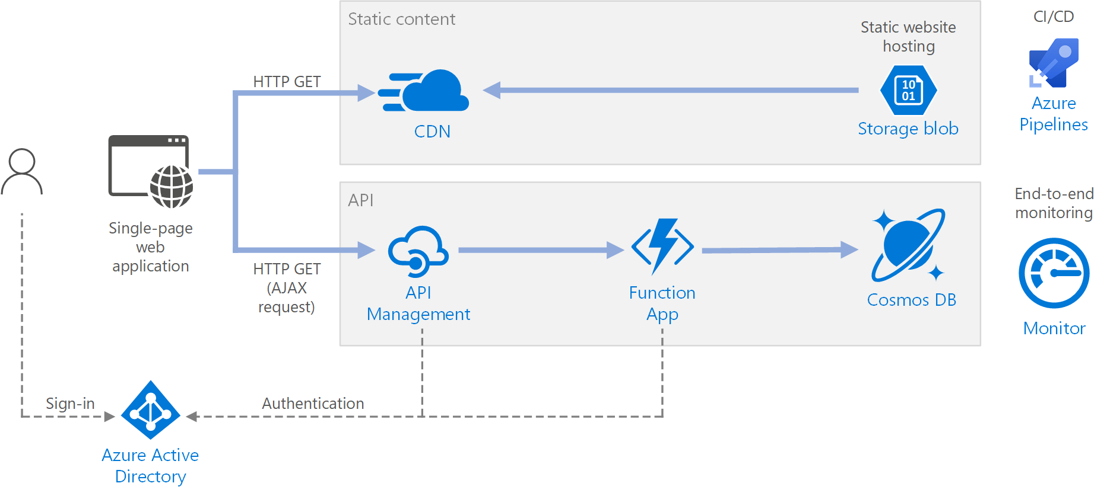
Serverless Web Application

Slide 39
Exam AZ-301 Item Types

Slide 40

Multiple Choice

Slide 41
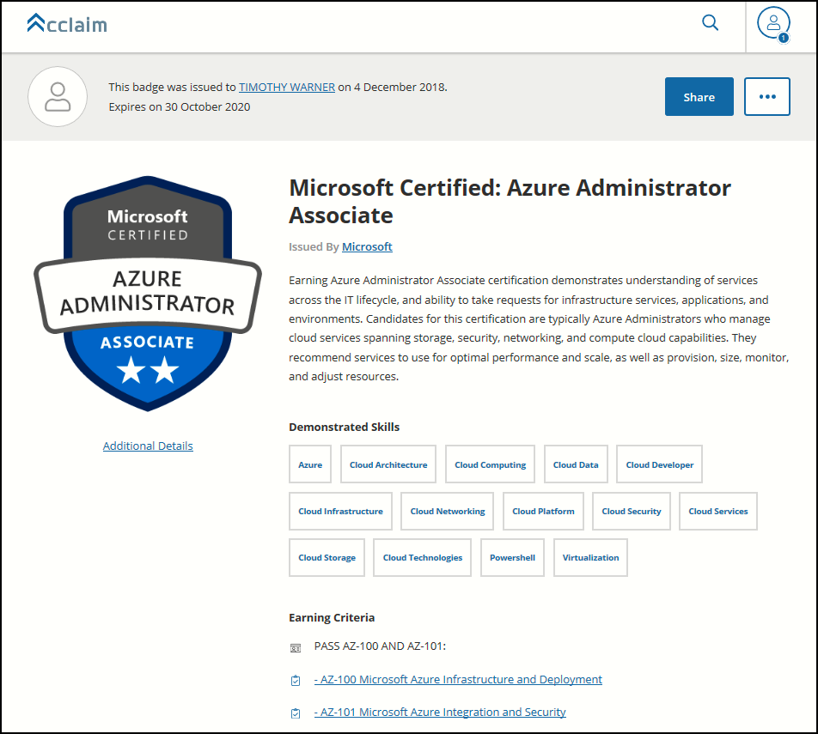
Digital Credentials by Credly/Acclaim

Slide 42
Repeated Scenario
You need to move an Azure VM to another hardware host.
Solution: You redeploy the VM.
Does this solution meet the goal?
Yes
No

Slide 43

Select and Place

Slide 44

Build List and Reorder

Slide 45

Active Screen/Fill in the Blank

Slide 46

Case Study

Slide 47






Performance-Based Lab

Slide 48
AZ-301 Exam Strategy/Tips
Does exam order matter?
What’s the difference between AZ-300 and AZ-301?
Does AZ-301 have performance-based labs?

Slide 49
AZ-301 Exam Strategy/Tips
Focus your skills accordingly:
60 percent Azure portal
20 percent Azure PowerShell
10 percent Azure CLI
10 percent KQL
Expect performance-based labs

Slide 50
AZ-301 Exam Strategy/Tips
Expect to see lots and lots and lots of JSON
Performance-based labs
Open a second tab for shell.azure.com
Don't be afraid to file an item challenge/grievance

Slide 51
Thank you!
Course materials: timw.info/az300
Twitter: @TechTrainerTim
Work: Pluralsight.com
Web: TechTrainerTim.com

